Slide 1






RestoMetrics
www.RestoMetrics.com
RestoMetrics
Javier Martínez Ochoa

Slide 2

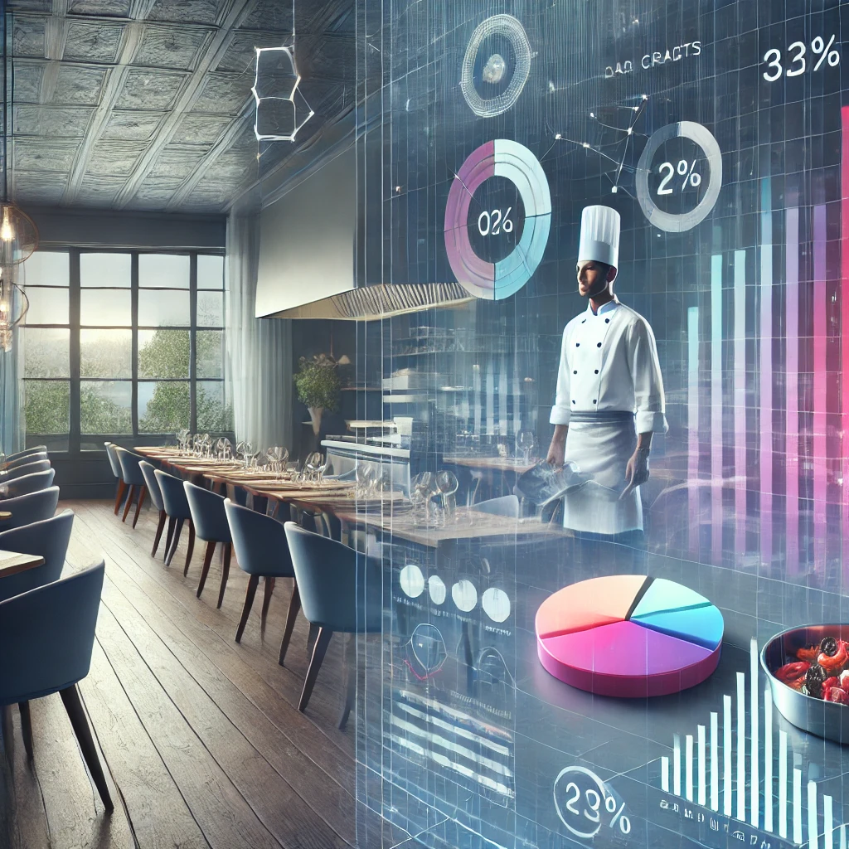
RestoMetrics
Introduction
Introduction
Introduction
RestroMetrics offers a simple and intuitive solution for restaurant owners to explore various data scenarios and analyze potential revenue variations with ease.
This powerful tool helps you make data-driven decisions, optimize your strategies, and gain insights into your restaurant's financial potential.

Slide 3


RestoMetrics
Introduction
Objectives
Objectives
Objectives
Issue
Showcase
Conclusions
Understanding why RestoMetrics is useful is key.
Restaurant management is complex, and without proper oversight, success can be difficult to achieve
In this part we are going to show the actual web-app and analyze all its features and functionalities.
Finishing with the final conclusions and the overall analysis of the tool and see future implementations and uses.

Slide 4





RestoMetrics
Introduction
Objectives
Implementation Details
Implementation Details
Implementation Details
Frontend
Built using HTML and CSS to create a user-friendly interface for data input and displaying the variance in predictions for restaurants to analyze.
Backend
The behind the scenes using Python to handle requests, process data, and communicate with the predictive models.

Slide 5

RestoMetrics
Introduction
Objectives
Implementation Details
Issue
Issue
Issue
After 1 year opened
60%
40%
Why restaurants fail?
The reasons often include poor financial planning, inadequate scenario analysis, and inefficient resource allocation.
20%
After 5 years opened
80%
RestoMetrics addresses this issue by providing restaurant owners with a powerful tool. By visualizing how changes in variables can impact revenue.
Success
Fail

Slide 6

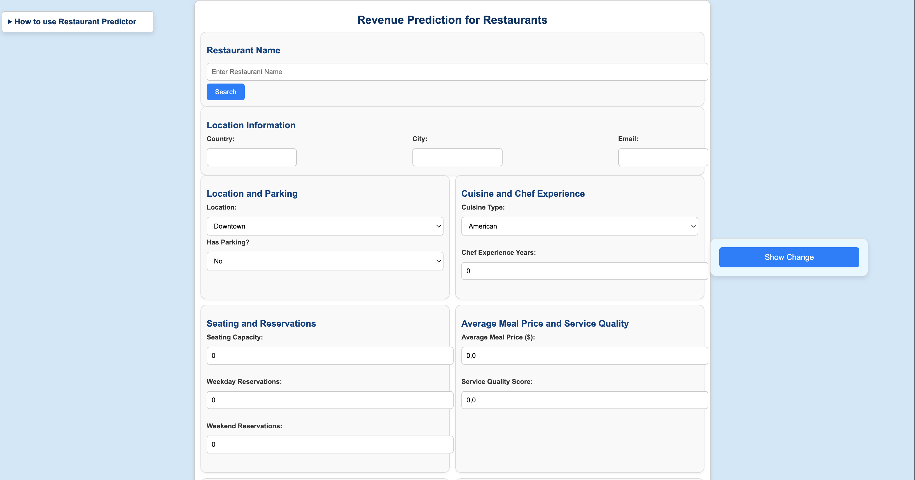


RestoMetrics
Introduction
Objectives
Implementation Details
Issue
Showcase
Showcase
Showcase
How does it work?
First, search your restaurant on our database to help you fill in some data. Then, add the additional data and save it in our system. Perform different scenarios by modifying the data and see how your revenue will perform.
(Click the monitor image and see it yourself)

Slide 7

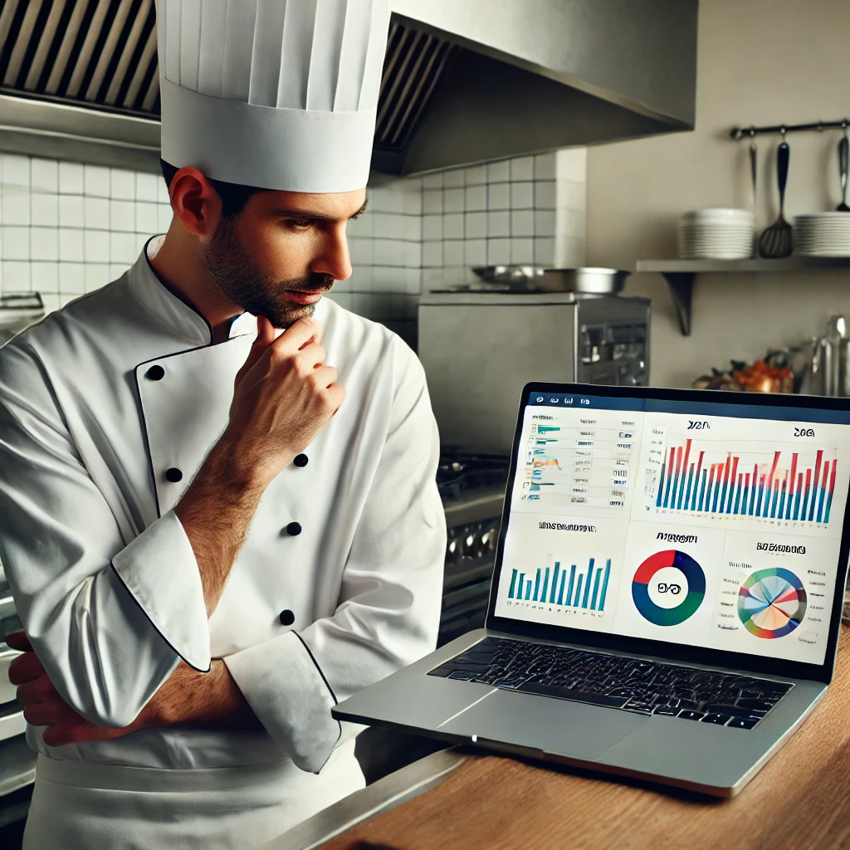
RestoMetrics
Introduction
Objectives
Implementation Details
Issue
Showcase
Conclusion
Conclusion
Conclusion
This template would help you save a lot of time and hassle. Jumpstart your design by quickly drafting a complete outline of your presentation and filling in the details here.
Choose from over a thousand professionally-made templates to fit any objective or topic.

